Slide 1
OPERATION SHEDULING
Authored by
Amit Kumar De
M.COM., M.A.,M.B.A., M.Phil.,A.I.C.W.A., L.L.B.,PGDFA,CFM

Slide 2
Introduction
Scheduling is a process of setting up operation processing times so that jobs will be completed on time.
Scheduling of operations helps in providing the best service to customers by making efficient use of the firm’s resources.

Slide 3
Purpose of Scheduling
maximizing customer satisfaction and minimizing service delays
optimum allocation of their production capacity and resources to meet customer requirements on time
carry out the production process most efficiently, reduce costs, and increase profitability

Slide 4
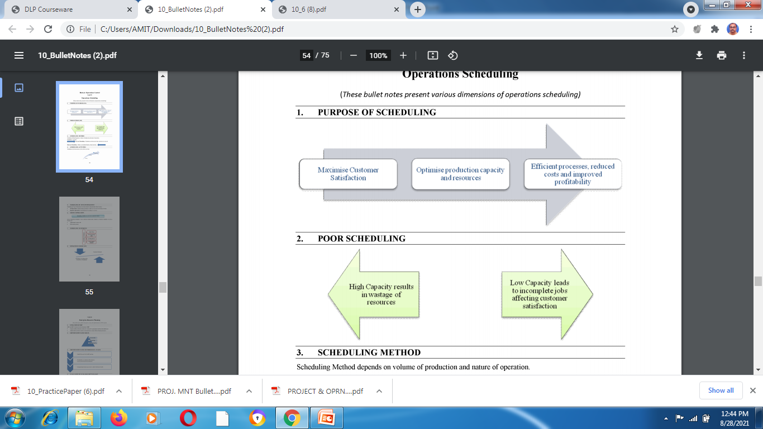

Slide 5
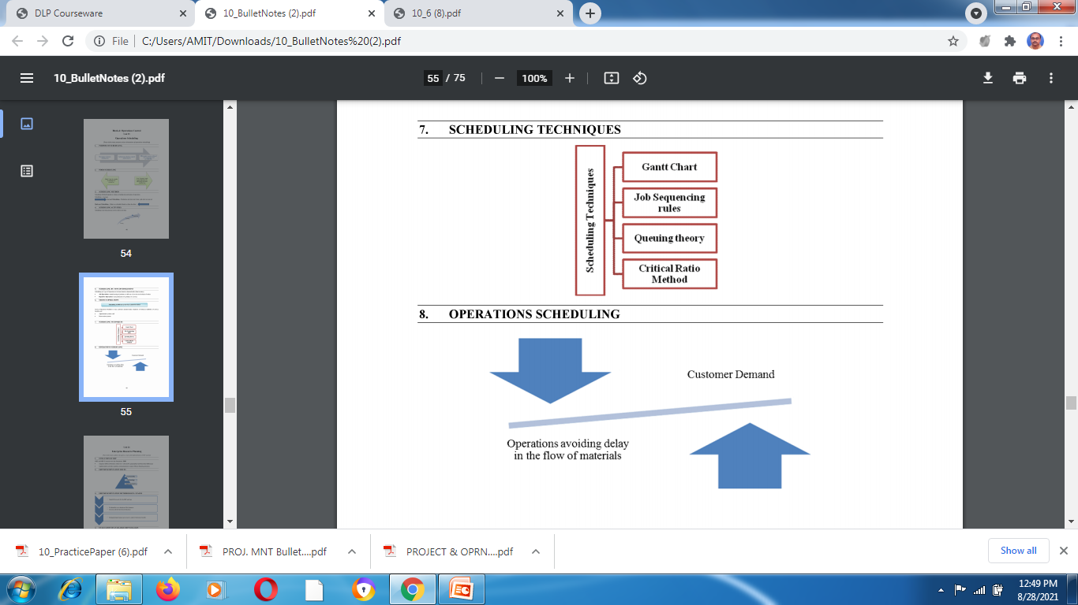

Slide 6
Forward Scheduling
actual production activities start when a job order is received
determines the start and finish times for jobs by assigning them to the earliest available time slots
used in fabrication operations where products are customized

Slide 7
Backward Scheduling
orders are scheduled based on their due dates
develops the schedule backward, thereby determining the latest point when the production activity can be started in order to complete the order on time
used in service organizations when the demand for services is anticipated earlier

Slide 8
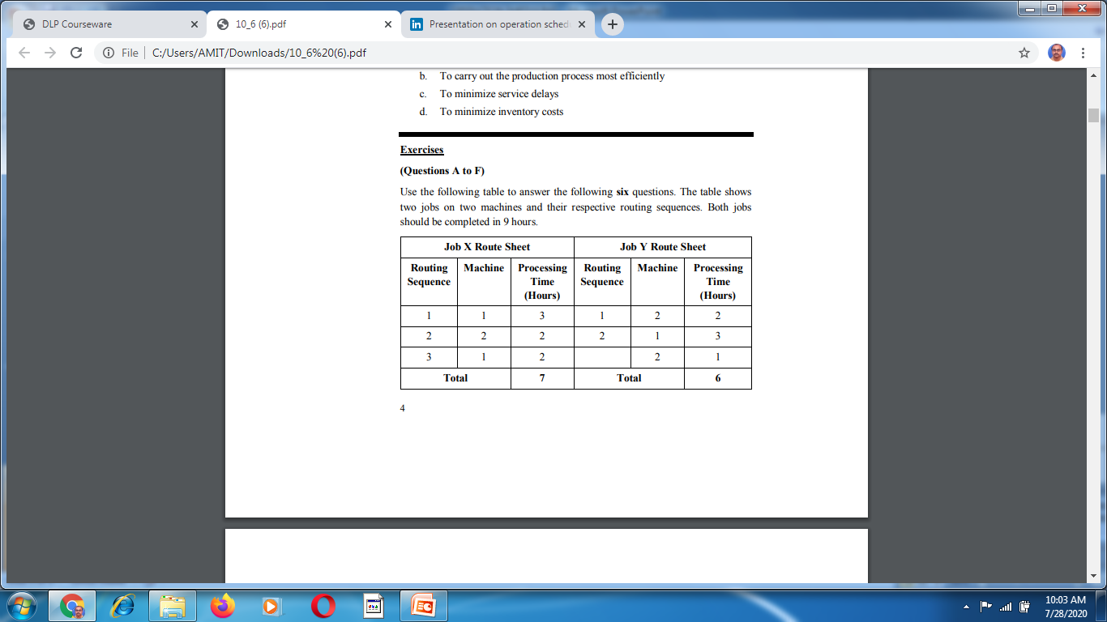
A. What will be the representation of forward scheduling for Jobs X and Y? B. What will be the representation of backward scheduling for Jobs X and Y? C. Using forward scheduling, what is the earliest finish time of Job X? D. What is the earliest finish time of Job Y in forward scheduling? E. What is the latest start
What will be the representation of forward scheduling for Jobs X and Y? B. What will be the representation of backward scheduling for Jobs X and Y? C. Using forward scheduling, what is the earliest finish time of Job X? D. What is the earliest finish time of Job Y in forward scheduling? E. What is the latest start time for Job X in backward scheduling? F. What is the latest start time for Job Y in backward

Slide 9
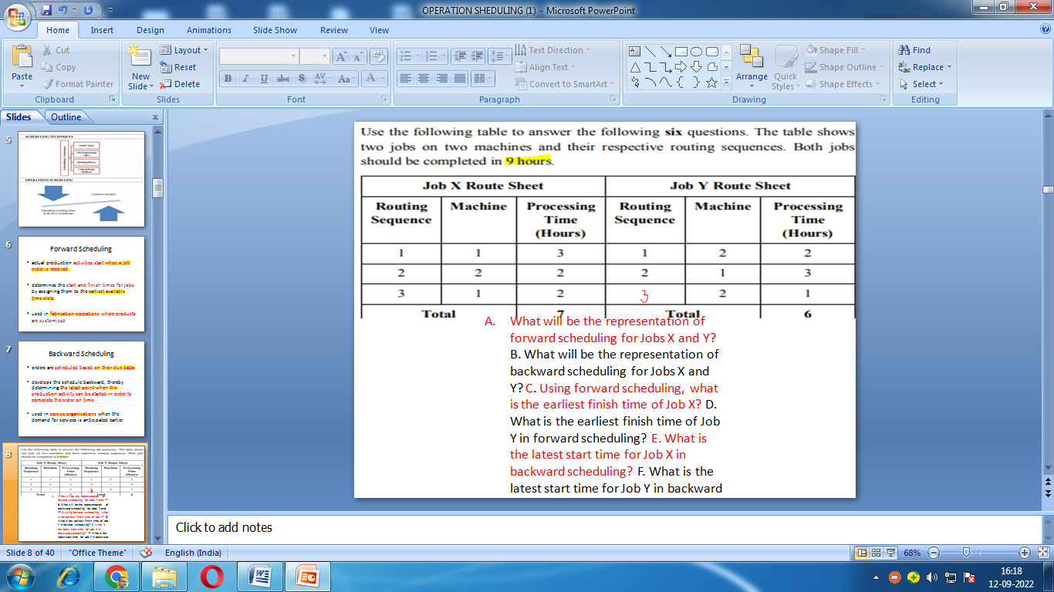

Slide 10
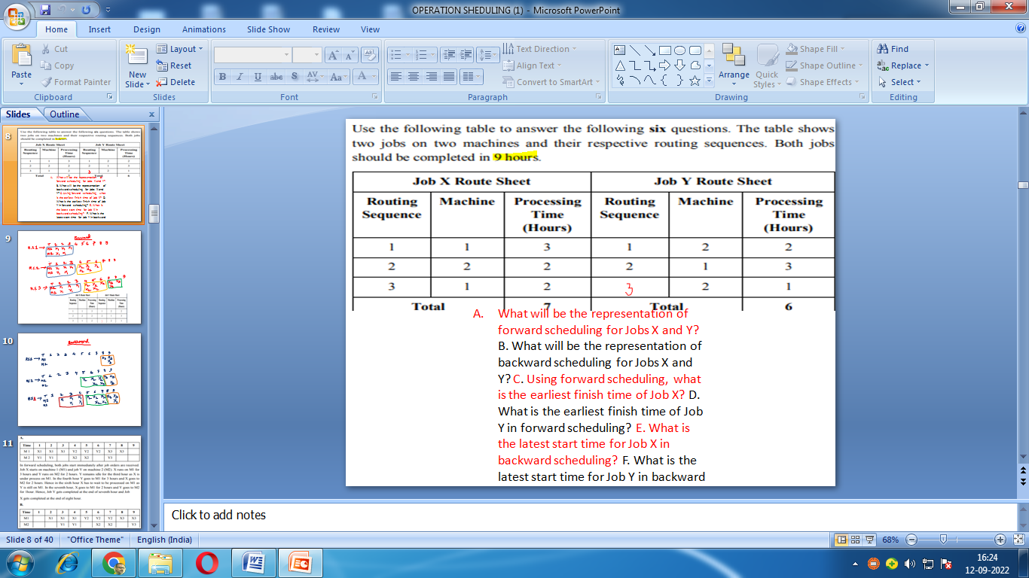

Slide 11
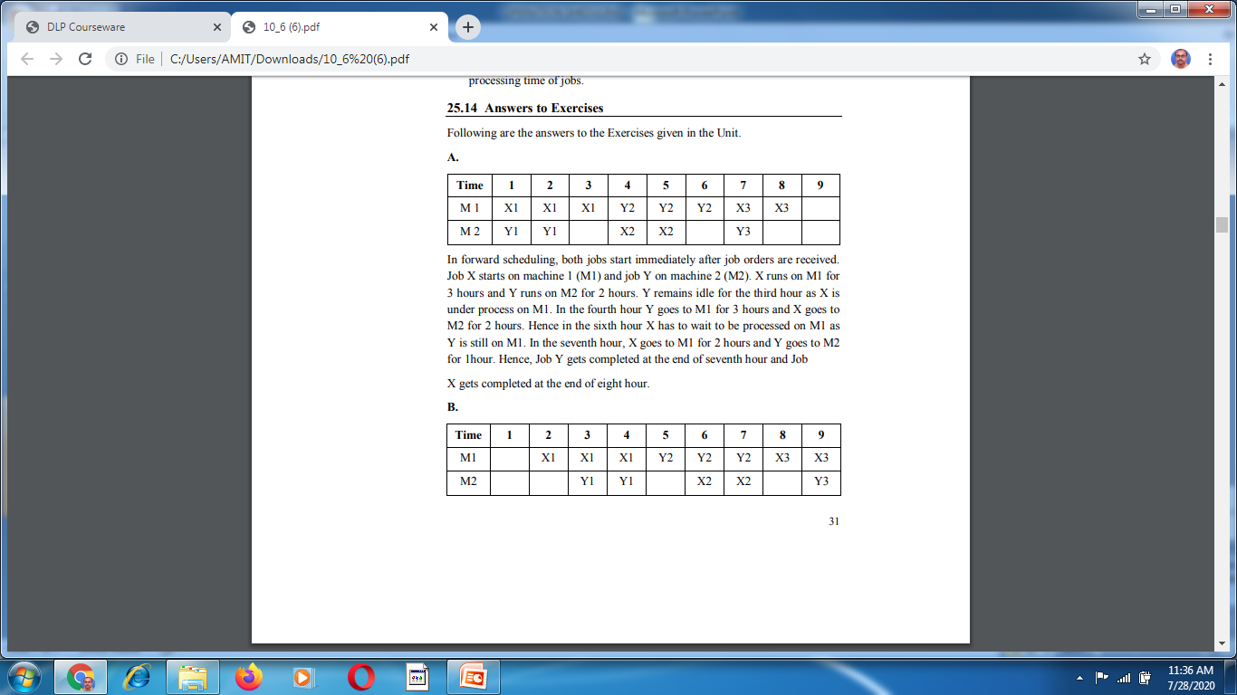

Slide 12
SOLUTION CONTINUED
B. In backward scheduling, the schedule is calculated backwards from the due date of completion. As this is nine hours, scheduling starts at the ninth hour and works backwards. Here the last sequence for jobs X and Y are placed at the ninth hour. X3 needs 2 hours and Y needs 1 hour. M1 is occupied up to the eighth hour. In the seventh hour Y2 is processed on M1 and X2 on M2. Y2 requires 3 hours and X2 requires 2hours. Y2 would be on M1 until fifth hour and X2 would be completed in the sixth hour itself. In the fourth hour, X1 must be completed on M1 and Y1 on M2 in the third hour. Hence, X1 starts in the second hour and Y1 in the third hour.
C. 8 hours D. 7 hours E. 2 hours F. 3 hours

Slide 13
Johnson’s Job Sequencing Rules
It maximizes operations efficiency, minimizes processing time of jobs, reduces processing costs over a period of time.
Jobs processed in single stage of production can be simply scheduled one after another whereas for those involving two or more stages of production, firms should ensure that jobs sequenced in a way which minimizes the idle time.
Operations managers use Johnson’s rules to develop a job sequence that minimizes total time span required in completing given jobs.

Slide 14
Johnson’s rule for two-stage production
Assume that the firm has to perform ‘n’ jobs and each job involves processing on two machines A and B in the order AB. For example, the job involves first the printing operation in machine A and then the binding operation in machine B. There are ‘n’ numbers of books that are to be printed and then bound. Assume the expected processing times of these jobs are A1, A2,---An on machine A and B1, B2,---Bn on machine B.
We should determine the sequence in which the n jobs should be processed using the two machines in order to minimize the total elapsed time. To solve the above problem, Johnson and Bellman developed the following steps:

Slide 15
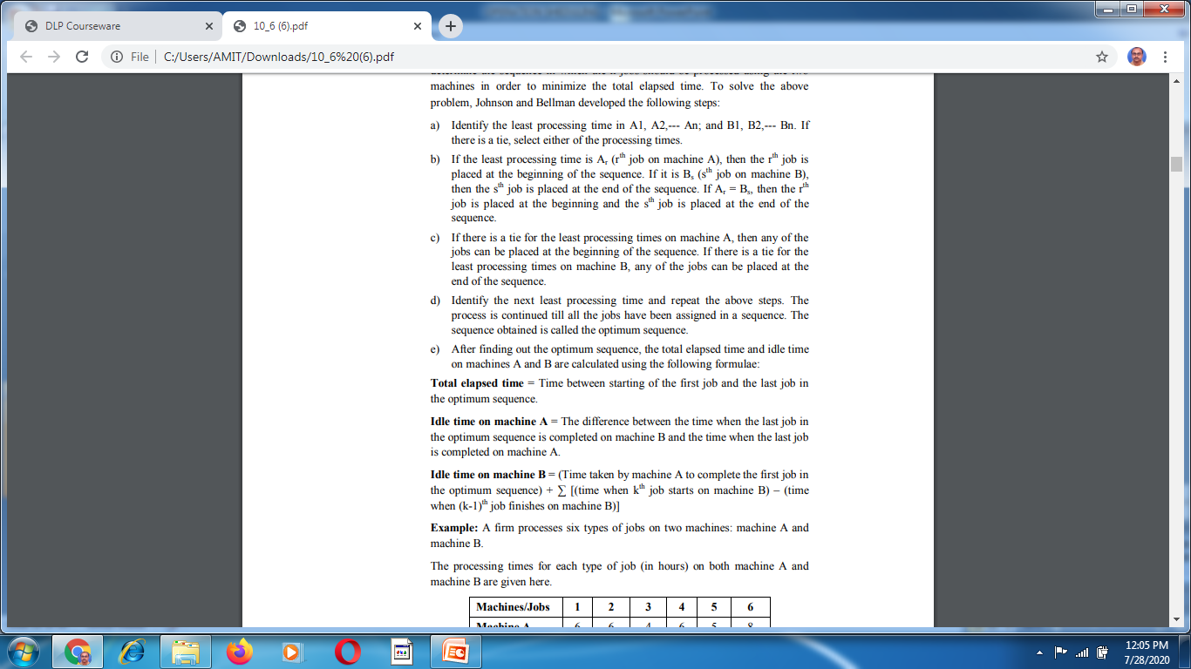

Slide 16
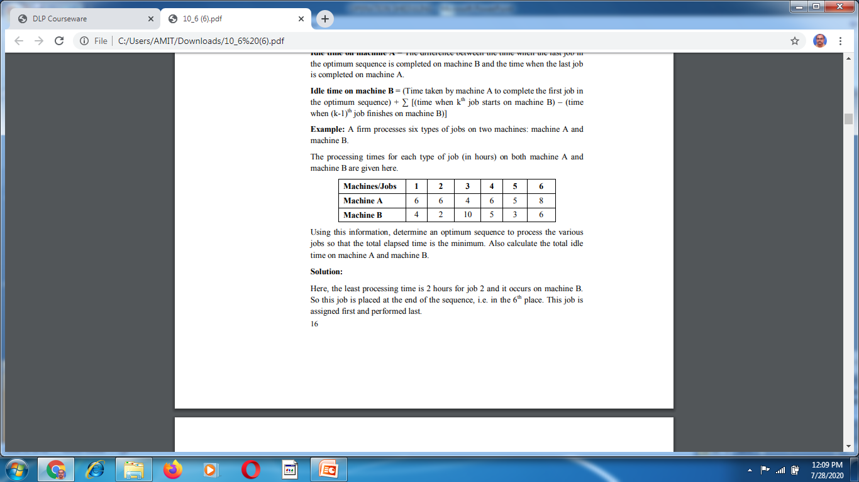

Slide 18
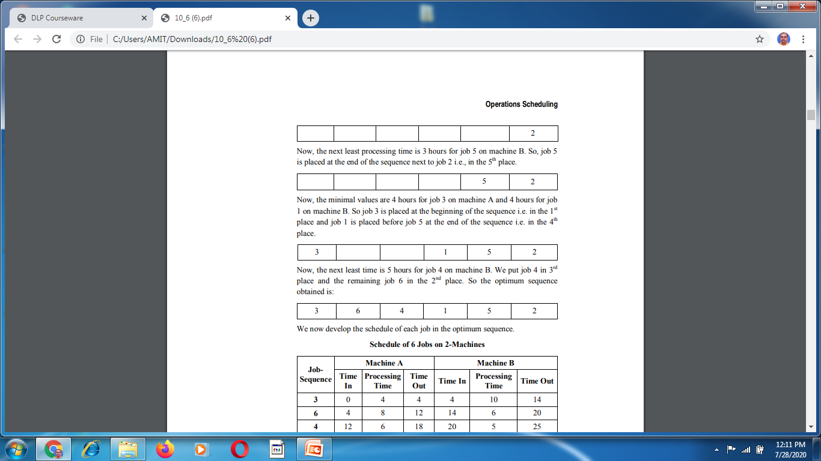

Slide 20
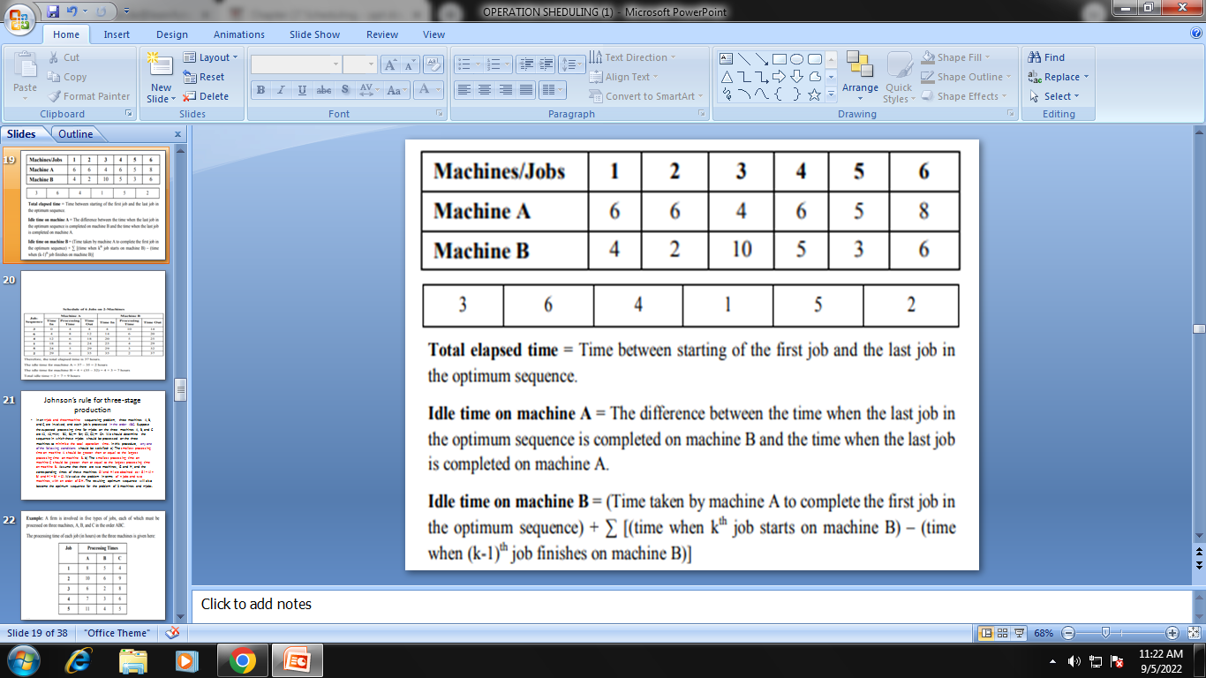
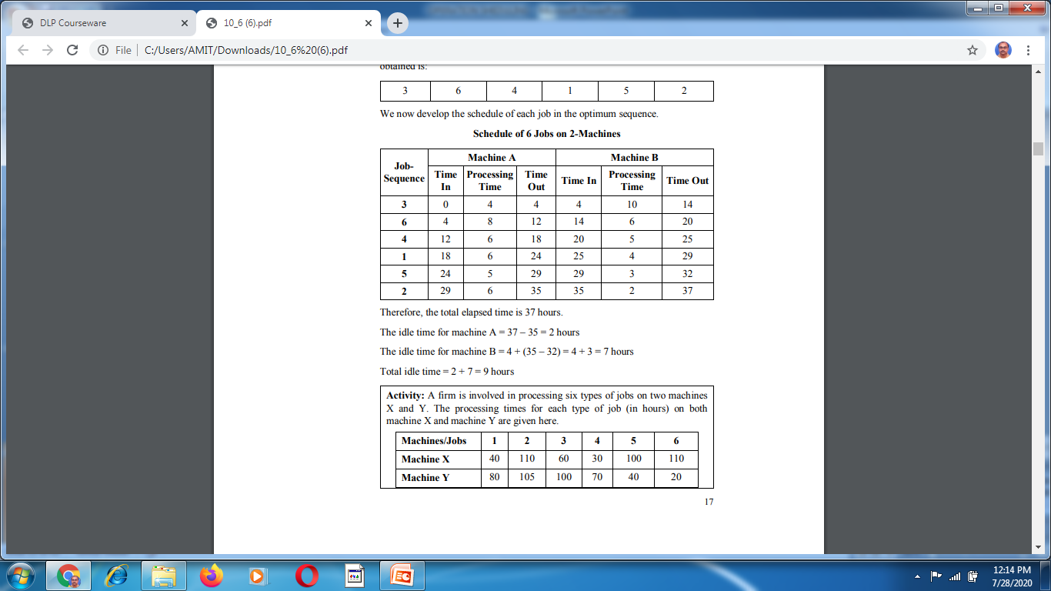

Slide 21
Johnson’s rule for three-stage production
In an n-job and three-machine sequencing problem, three machines A, B, and C, are involved, and each job is processed in the order ABC. Suppose the expected processing time for n-jobs on the three machines A, B, and C are A1, A2,---An; B1, B2,--- Bn; C1, C2,--- Cn. We should determine the sequence in which these n-jobs should be processed on the three machines to minimize the total operation time. In this procedure, any one of the following conditions should be satisfied: a) The smallest processing time on machine A should be greater than or equal to the largest processing time on machine B. b) The smallest processing time on machine C should be greater than or equal to the largest processing time on machine B. Assume that there are two machines, G and H, and the corresponding times of these machines Gi and Hi are obtained as: Gi = Ai + Bi and Hi = Bi + Ci. We solve the problem in terms of n jobs and two machines, with an order of GH. The resulting optimum sequence will also become the optimum sequence for the problem of 3 machines and n-jobs.

Slide 22
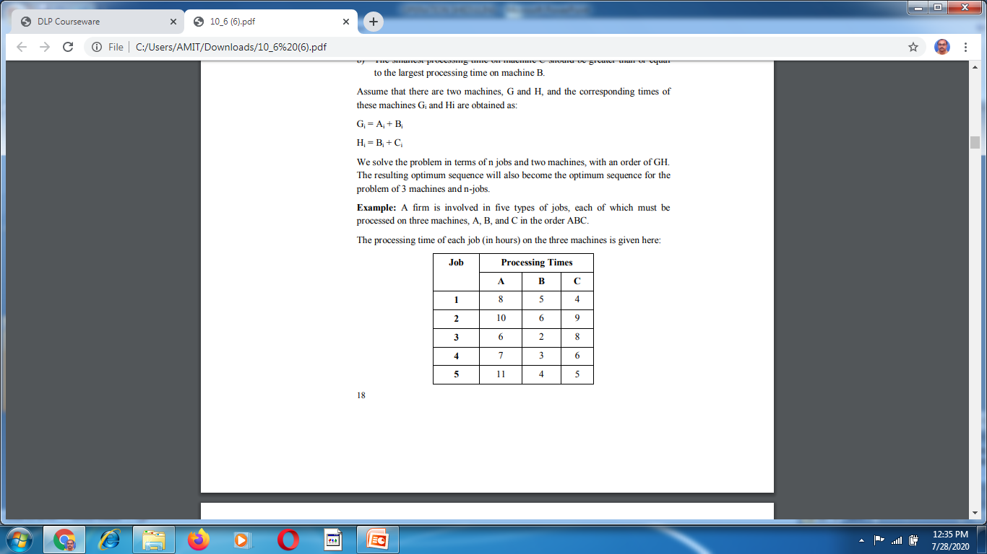

Slide 23
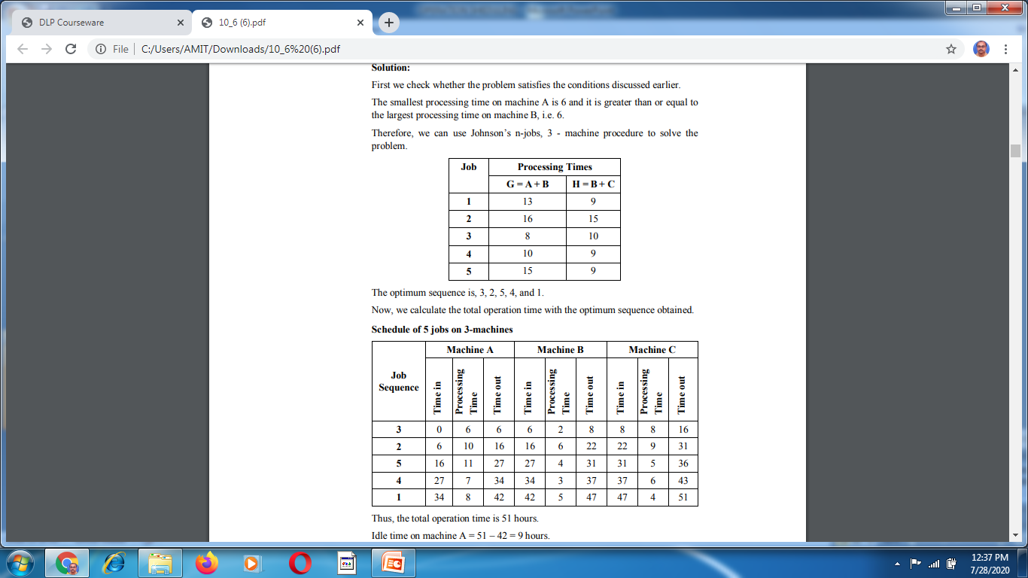

Slide 24
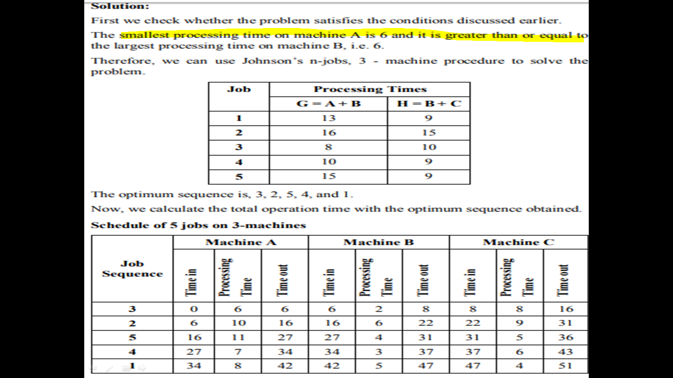

Slide 26
Solution continued
Thus, the total operation time is 51 hours.
Idle time on machine A = 51 – 42 = 9 hours.
Idle time on machine B = 6 + [(16 – 8) + (27 –22) + (34 – 31) + (42 – 37)] + (51 – 47) = 6 + 8 + 5 + 3 + 5 + 4 = 31 hours.
Idle time on machine C = 8 + [(22 – 16) + (37 – 36) + (47 – 43)] = 8 + 6 + 1 + 4 = 19 hours. Total idle time = 9 + 31 + 19 = 59 hours

Slide 27
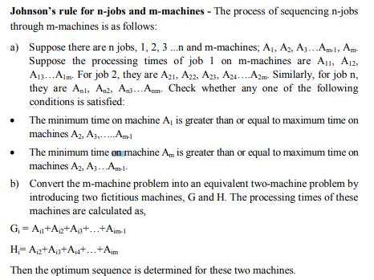

Slide 28
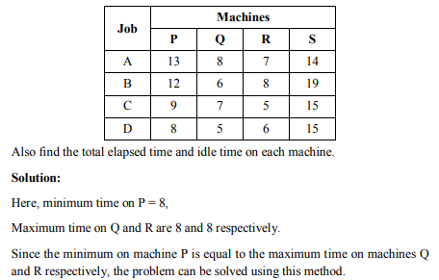
Example: Determine the optimum sequence of processing for the given sequencing problem of four jobs: A, B, C, D and four machines: P, Q, R, and S.

Slide 29
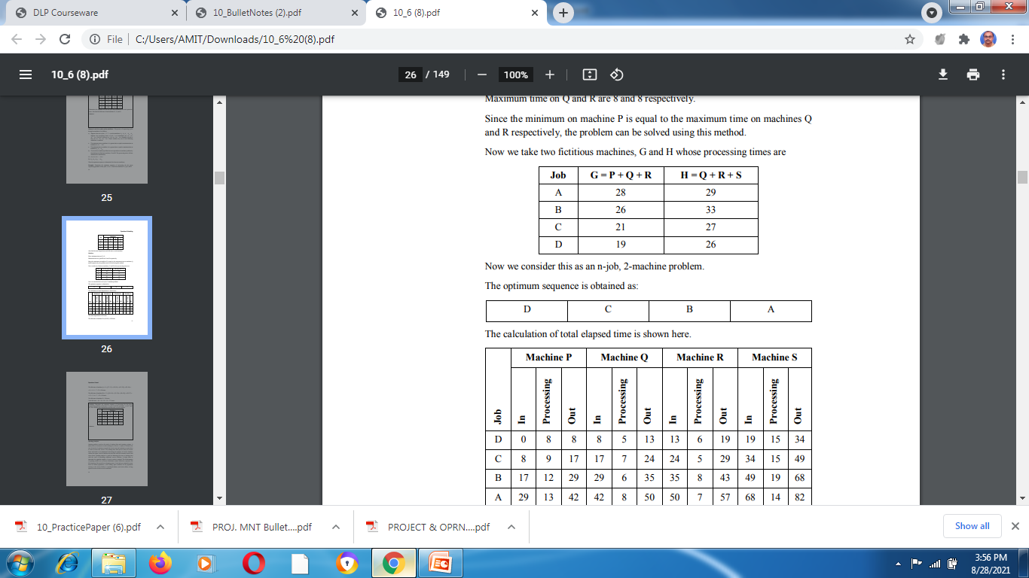

Slide 31
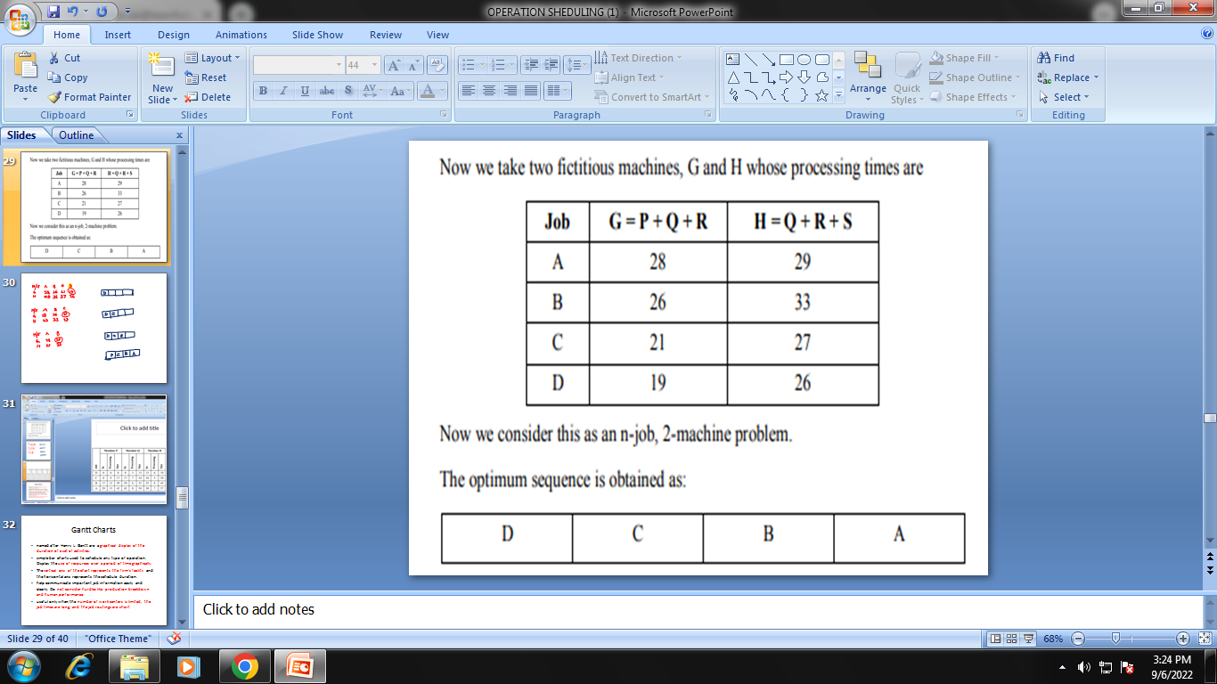
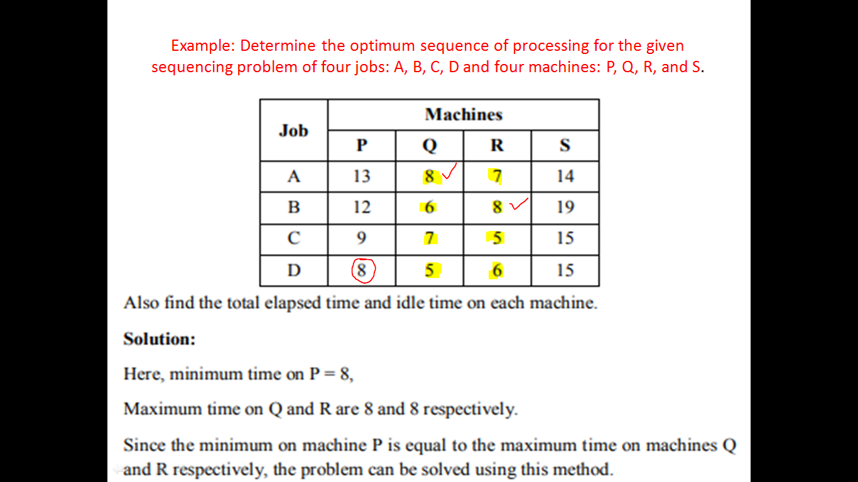
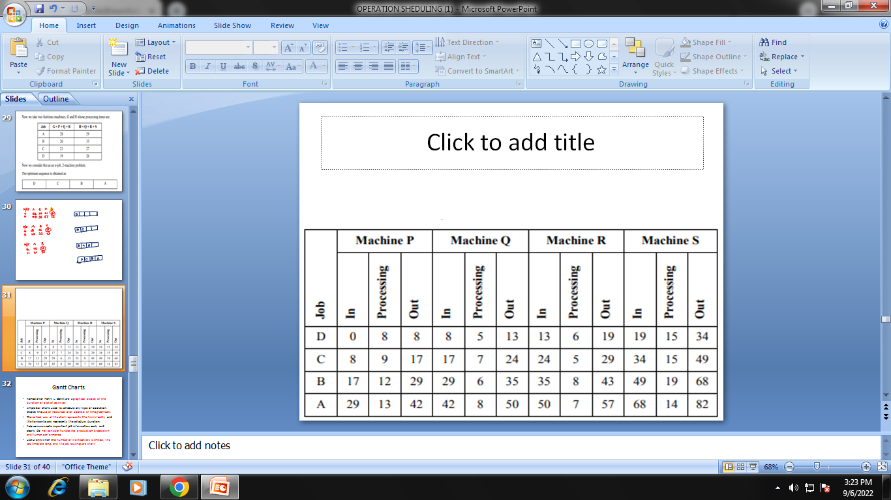
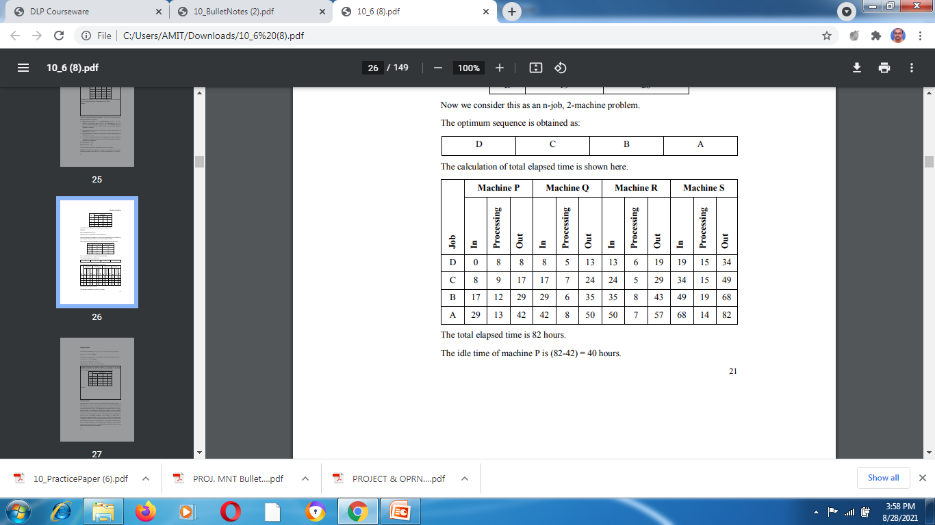

Slide 32
Gantt Charts
named after Henry L. Gantt are a graphical display of the duration of a set of activities.
simple bar charts used to schedule any type of operation. Display the use of resources over a period of time graphically.
The vertical axis of the chart represents the firm’s facility and the horizontal axis represents the schedule duration.
help communicate important job information easily and clearly. Do not consider hurdles like production breakdown and human performance.
useful only when the number of work centers is limited, the job times are long, and the job routings are short

Slide 33
Gantt Charts
named after Henry L. Gantt are a graphical display of the duration of a set of activities.
simple bar charts used to schedule any type of operation. Display the use of resources over a period of time graphically.
The vertical axis of the chart represents the firm’s facility and the horizontal axis represents the schedule duration.
help communicate important job information easily and clearly. Do not consider hurdles like production breakdown and human performance.
useful only when the number of work centers is limited, the job times are long, and the job routings are short

Slide 34
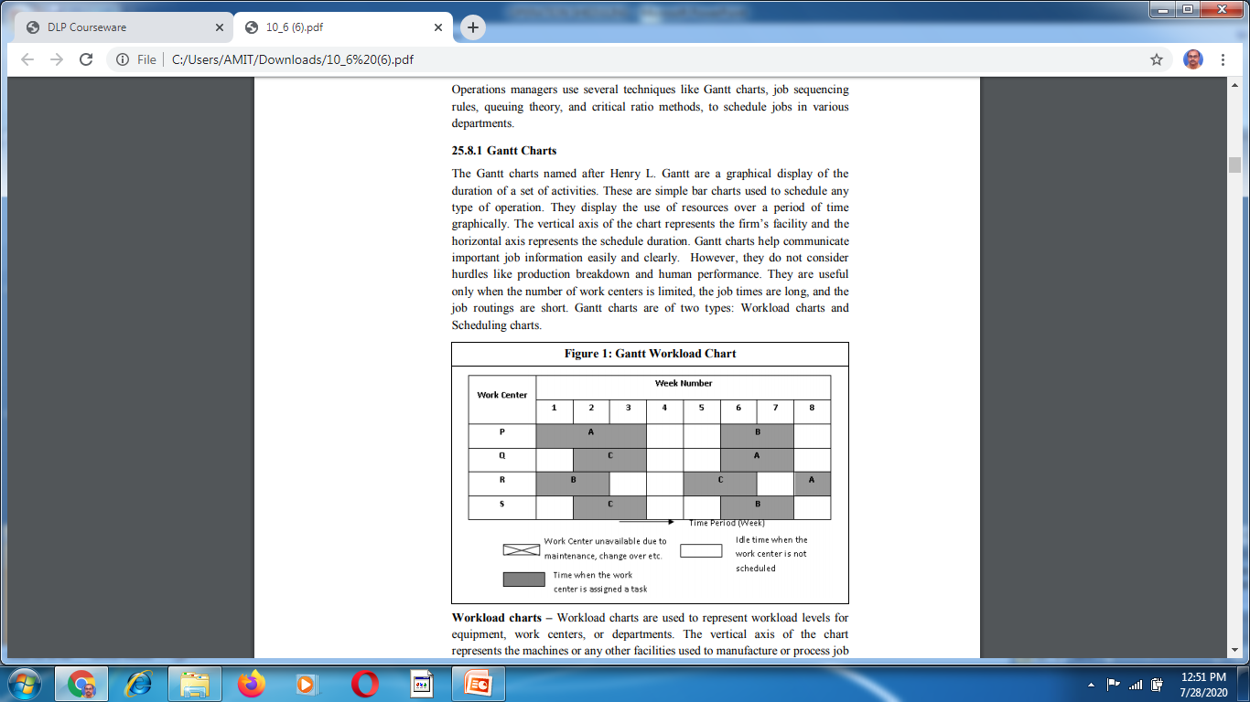

Slide 35
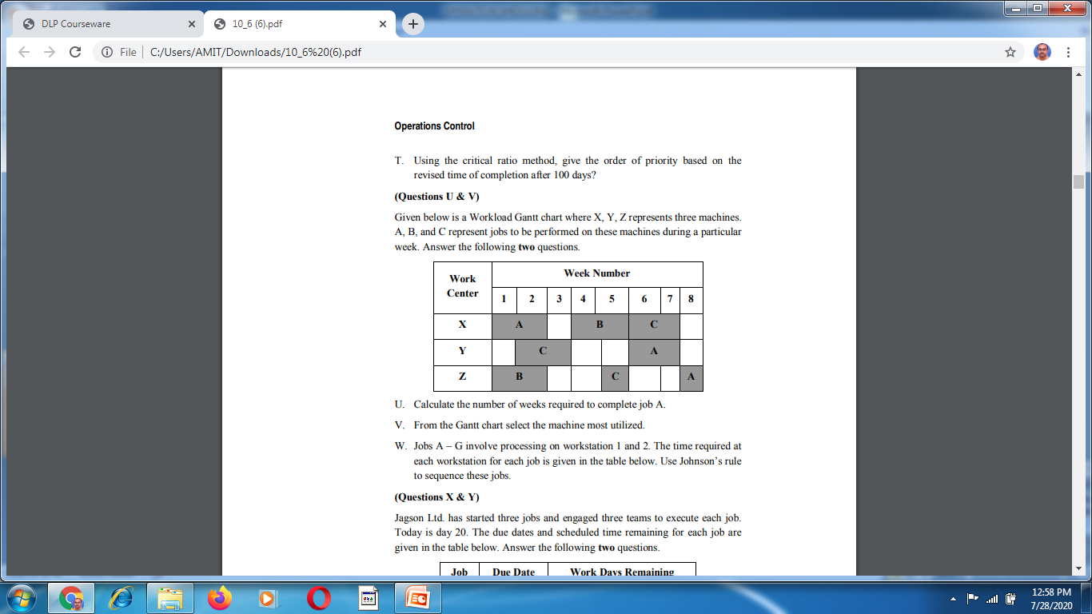

Slide 36
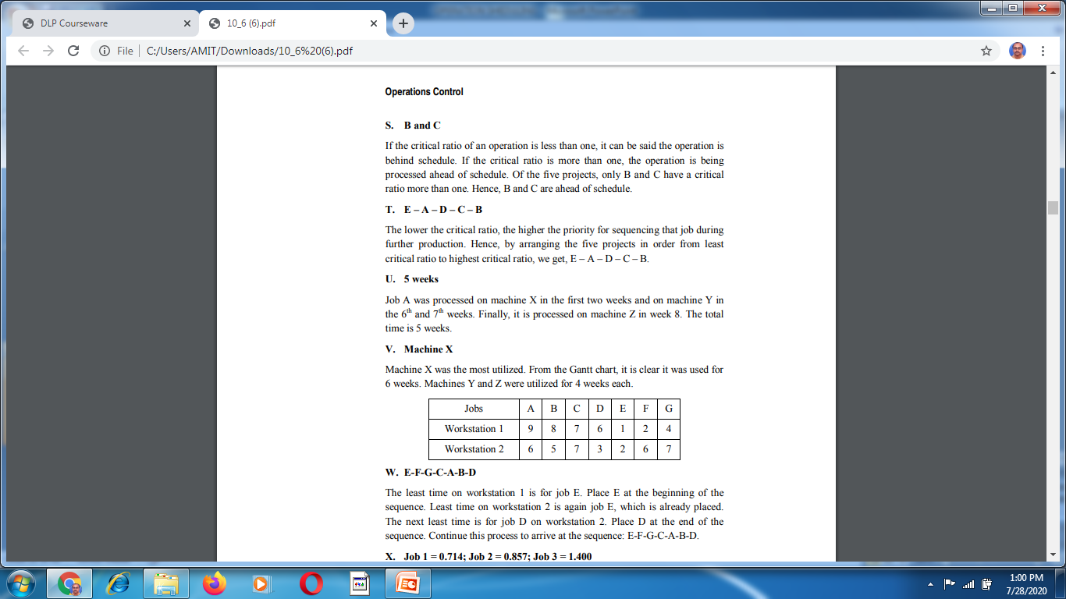
SOLUTION

Slide 37
Critical Ratio Method
technique of job sequencing used to verify whether a job is being operated on schedule.
Critical Ratio = Actual time remaining to complete the job / Sheduled time remaining to complete the job.
The operation is considered to be behind schedule if the critical ratio is less than one. If it is more than one, the operation is considered to have been processed ahead of schedule.
The method is used to revise the job status from time to time and to re-prioritize them.

Slide 38
PROBLEM
Crescent SoftDesign, a designing company, currently has five projects A, B, C, D, and E on hand which require150 days, 135 days, 180 days, 140 days and 120 days respectively to complete. After 100 days, the operations manager identifies that these projects still require 60 days, 30 days, 70 days, 45 days and 30 days respectively for completion. Based on the given information, answer the following three questions.
R. Which of the projects has the least critical ratio?
S. Which of projects is(are) ahead of schedule?
T. Using the critical ratio method, give the order of priority based on the revised time of completion after 100 days?

Slide 39
SOLUTION
R. Critical ratio for Project A = (150 -100)/60 = 0.833,
Critical ratio for Project B = (135 - 00)/30 = 1.167, Critical ratio for Project C = (180 -100)/70 = 1.143, Critical ratio for Project D = (140 -100)/45 = 0.889, Critical ratio for Project E = (120 -100)/30 = 0.667.
Projects A, D and E have critical ratio less than one. Hence they are on priority as they are behind schedule. Among them Project E has the least critical ratio of 0.667 and therefore is of highest priority.

Slide 40
SOLUTION CONTINUED
S. Of the five projects, only B and C have a critical ratio more than one. Hence, B and C are ahead of schedule.
T. E – A – D – C – B The lower the critical ratio, the higher the priority for sequencing that job during further production. Hence, by arranging the five projects in order from least critical ratio to highest critical ratio, we get, E – A – D – C – B.

